Slide 1


Slide 2
Outline
Tree
Binary Tree
  Complete Binary Tree
  Extended Binary Tree
  Threaded Binary Tree
  Balanced Binary Tree
Binary Search Tree
M-Way Search Tree/B-Tree
B+- Tree
AVL Search Tree
Spanning Tree
Heap Tree
Red-Black Tree
Traversals (pre-order, in-order, post-order) and more tree related algorithms/data structures ...

Slide 3
Tree
A non-linear data structure mainly used to represent data containing a hierarchical relationship between elements, e.g., records, family tree, table of contents, etc.
Formal Definition:
A tree is a collection of nodes. The collection can be empty; otherwise, a tree consists of a distinguished node ‘r’, called the root, and zero or more nonempty (sub)trees T_{1,} T_{2,} T_{3, ………………..,} T_{k,} each of whose roots are connected by a directed edge from ‘r’.

Slide 4
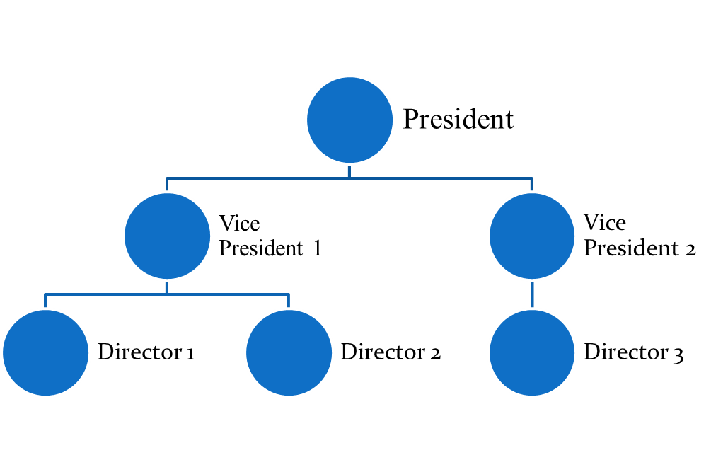
Example : Organization Hierarchy

Slide 5
A Tree
A
B
C
D
E
F
G
H
I
J
K
L
M
N
P
Q

Slide 6
Implementation of Trees
One way to implement a tree would be to have in each node, besides its data, a pointer to each child of the node. However, since the number of children per node can vary so greatly and is not known in advance, it might be infeasible to make the children direct links in the data structure, because there would be too much wasted space.
So, the solution is simple: keep the children of each node in a linked list of tree nodes.
The declaration would be like:
typedef struct treenode{
int element;
struct treenode *firstchild;
struct treenode *nextsibling;
} rootnode;

Slide 7
First Child/next sibling representation of the tree
A
B
C
D
E
F
G
H
I
J
K
L
M
N
P
Q

Slide 8
Terms
Node Degree of a Node
• Edge Degree of a Tree
• Root Leaf or Terminal Node
• Parent Non-Leaf or Non- Terminal or Internal Node
• Child Level of a Node
• Ancestor Depth of a Node
• Descendant Depth/Height of a tree
• Siblings
• Path
• SubTree

Slide 9
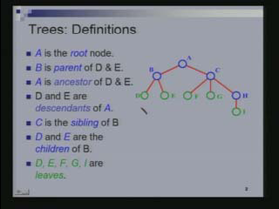

Slide 10
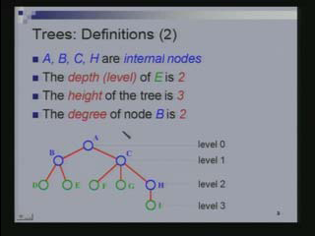

Slide 11
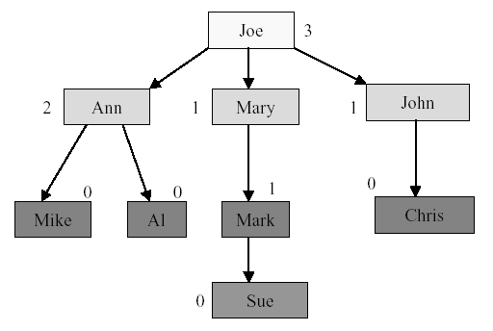
Node Degree
Node degree is the number of children it has

Slide 12
Degree/Tree Degree
Tree degree is the maximum of node degrees
tree degree = 3

Slide 13
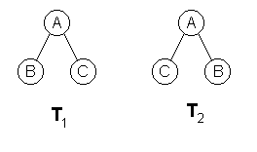
Ordered Tree
An ordered tree is an oriented tree in which the children of a node are somehow "ordered."
If T₁ and T₂ are ordered trees then T₁ ≠ T₂ else T₁ = T₂.

Slide 14
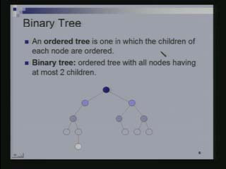

Slide 15
Binary Tree
A binary tree is composed of zero or more nodes
Each node contains:
  A value (some sort of data item)
  A reference or pointer to a left child (may be null), and
  A reference or pointer to a right child (may be null)
A binary tree may be empty (contain no nodes)
If not empty, a binary tree has a root node
  Every node in the binary tree is reachable from the root node by a unique path
A node with no left child and no right child is called a leaf

Slide 16

The root is drawn at the top
a
b
c
d
e
f
g
h
i
j
k
l

Slide 17
Left ≠ Right
The following two binary trees are different:
A
A
B
B
In the first binary tree, node A has a left child but no right child; in the second, node A has a right child but no left child

Slide 18
Difference Between a Tree & a Binary Tree
No node in a binary tree may have a degree more than 2, whereas there is no limit on the degree of a node in a tree.
The subtrees of a binary tree are ordered; those of a tree are not ordered.
a
a
- different when viewed as a binary tree
- same when viewed as a tree
b
c
c
b

Slide 19
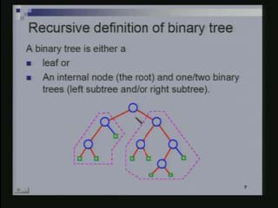

Slide 20
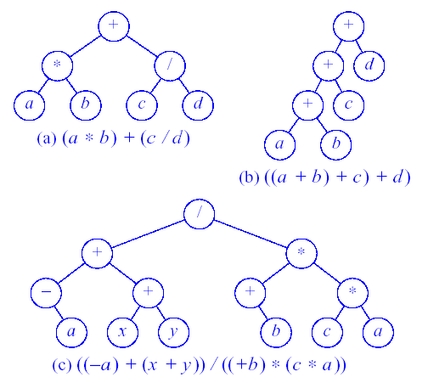
Binary Tree for Expressions
Expression Trees

Slide 21
Types of Binary Tree
Full Binary Tree
Complete Binary Tree (CBT)
Perfect Binary tree

Slide 22
Full Binary Tree
A Binary Tree is full if every node has either 0 or 2 children.
Or
A full binary tree is a binary tree in which all nodes except leaves have two children.

Slide 23
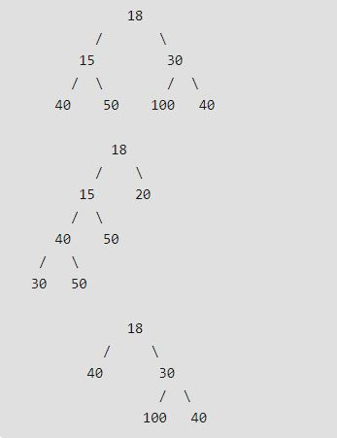
Examples of Full Binary Tree

Slide 24
Complete Binary Tree
A Binary Tree is said to be Complete
if each level of the tree, except the last level, have 2^{l} nodes, where ‘l’ is the level, and
(ii) If the last level doesn’t have 2^{l} nodes, then all nodes in the last level should be left alligned.

Slide 25
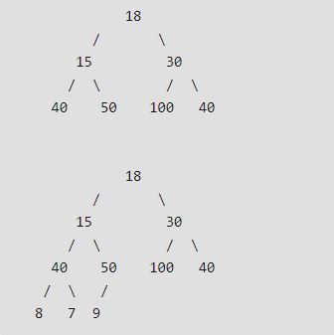
Examples of Complete Binary Tree

Slide 26
Perfect Binary Tree
A Binary tree is Perfect Binary Tree in which all internal nodes have two children and all leaves are at the same level.

Slide 27
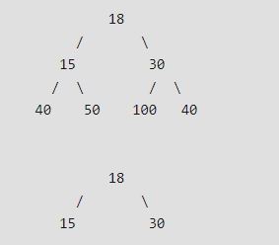
Examples of Perfect Binary Tree

Slide 28
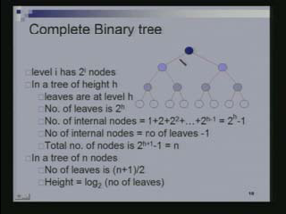

Slide 29
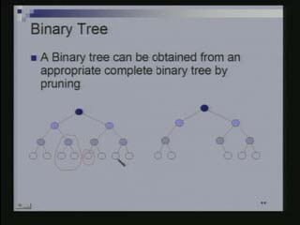

Slide 30
Minimum Height of a Binary Tree
A Binary Tree of height ‘h’ has :
    Atmost 2^{i} nodes at level i
    Atmost 1+2+ 2² + 2³ + ...+ 2^{h} = 2^{h+1} -1 nodes.
If the tree has ‘n’ nodes, then:
    n < = 2^{h+1} – 1
    hence, h > = log₂ (n + 1)/ 2

Slide 31
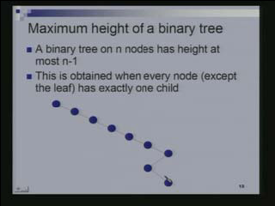

Slide 32
No. of leaves in a Binary Tree
No. of leaves < = 1 + no. of Internal Nodes
Proof: by Induction on No. of Internal Nodes.
    Tree with 1 node has a leaf but no internal node
    Assume statement is true for tree with K-1 internal nodes
    A tree with K internal nodes has k₁ internal node in left subtree and (K - k₁ – 1) internal nodes in right subtree.
No. of leaves < = (k₁ + 1 ) + ( K - k₁) = K + 1

Slide 33
Explanation
In a base case consider a tree with 1 node. If a tree has only 1 node how many internal nodes does it have?
It is 0, because that 1 node does not have any child so that is the leaf. Base case is when the number of internal nodes is 0, in which case the right hand side is 1 that is the number of leaves is 1 so the inequality is satisfied.
We will assume that the statement is true for all trees with less than or equal to K-1 internal nodes. This should be read as, the statement is true for trees with atmost K-1 internal nodes and not just K-1 but anything even for less this statement is true.

Slide 34
We will prove it for a tree with K internal nodes. Suppose I have a tree with K internal nodes, let us say on the left subtree I have k₁ internal node. Then how many internal nodes do I have on the right subtree? It is exactly K- k₁ -1 and not atmost because all the internal nodes are either in the left subtree or in the right subtree or it is the root node. The minus one is because of the root node. This is the number of internal nodes in the right subtree.
Let us apply the induction hypothesis. k₁ is less than or equal to K-1 and the quantity (K- k₁ -1) is also less than or equal to K-1. We can use the induction hypothesis. In the left subtree which has k₁ internal nodes, the number of leaves is less than or equal to k₁ +1. In the right subtree the number of leaves is less than or equal to K- k₁ -1+1 which is K- k₁ .
The total number of leaves is just the sum of these two ((k₁ +1) + (K- k₁ )), all the leaves are either in the left subtree or in the right subtree. The total number of leaves is just the sum which is K+1 that is we wanted to prove.

Slide 35
For a Binary Tree of ‘n’ Nodes:
No. of leaves + no. of Internal node = n
No. of leaves < = no. of Internal nodes + 1
Hence, no. of leaves < = (n + 1)/2
Minimum no. of leaves is 1

Slide 36
Operations on Trees
Insert
Delete
Search
Traverse

Slide 37
Binary Tree Traversal
Unlike linear data structures (Array, Linked List, Queues, Stacks, etc) which have only one logical way to traverse them, trees can be traversed in different ways.
Following are the generally used ways for traversing trees.

Slide 38
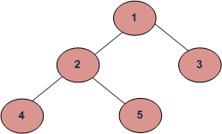
Depth First Traversals:
(a) Inorder (Left, Root, Right) : 4 2 5 1 3
(b) Preorder (Root, Left, Right) : 1 2 4 5 3
(c) Postorder (Left, Right, Root) : 4 5 2 3 1
Breadth First or Level Order Traversal : 1 2 3 4 5

Slide 39
Level Order Tree Traversal

Slide 40
Algorithm
For each node, first the node is visited and then it’s child nodes are put in a FIFO queue.
Create an empty queue q
temp_node = root /*start from root*/
Loop while temp_node is not NULL
a) print temp_node->data.
b) Enqueue temp_node’s children (first left then right children) to q
c) Dequeue a node from q and assign it’s value to temp_node

Slide 41
void level_order(node *root)
{
  node *temp = root;
  node *queue[Q_SIZE] = {NULL};
  int front = rear = 0;
  while (temp != NULL)
  {
  printf("%d ", temp->data);
  if (temp->left != NULL)
  {
  queue[rear] = temp->left;
  rear++;
  }

Slide 42
if (temp->right != NULL)
{
queue[rear] = temp->right;
rear++;
}
temp = queue[front++];
}
}

Slide 43
Depth Order Tree Traversal Methods
Preorder
  The root of the subtree is processed first before going into the left then right subtree (root, left, right).
Inorder
  After the complete processing of the left subtree the root is processed followed by the processing of the complete right subtree (left, root, right).
Postorder
  The root is processed only after the complete processing of the left and right subtree (left, right, root).

Slide 44
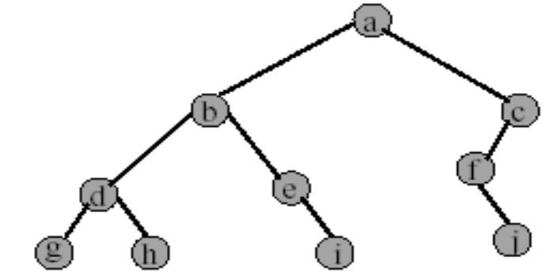
Preorder Example (visit = print)
a b d g h e i c f j

Slide 45
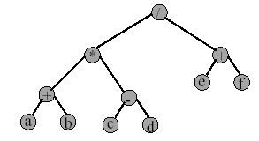
Preorder of Expression Tree
/ * + a b - c d + e f
Gives prefix form of expression.

Slide 46
PREORDER TRAVERSAL ALGORITHM
Preorder(N)
If(N== NULL) then return
else
Visit the root (N)
Traverse the left subtree i.e. call Preorder (N->leftchild)
Traverse the right subtree i.e. call Preorder(N->rightchild)

Slide 47
Inorder Example (visit = print)
g d h b e i a f j c

Slide 48
INORDER TRAVERSAL ALGORITHM
Inorder(N)
If(N== NULL) then return
else
Traverse the left subtree i.e. call Inorder (N->leftchild)
Visit the root node (N)
Traverse the right subtree i.e. call Inorder(N->rightchild)

Slide 49
Postorder Example (visit = print)
g h d i e b j f c a

Slide 50
POSTORDER TRAVERSAL ALGORITHM
Postorder(N)
If(N== NULL) then return
else
Traverse the left subtree i.e. call Postorder (N->leftchild)
Traverse the right subtree i.e. call Postorder(N->rightchild)
Visit the root node (N)

Slide 51
Time Complexity of Four Traversals
?????

Slide 52
Construct Tree from given Inorder and Preorder traversals
Let us consider the below traversals:
Inorder sequence: D B E A F C
Preorder sequence: A B D E C F

Slide 53
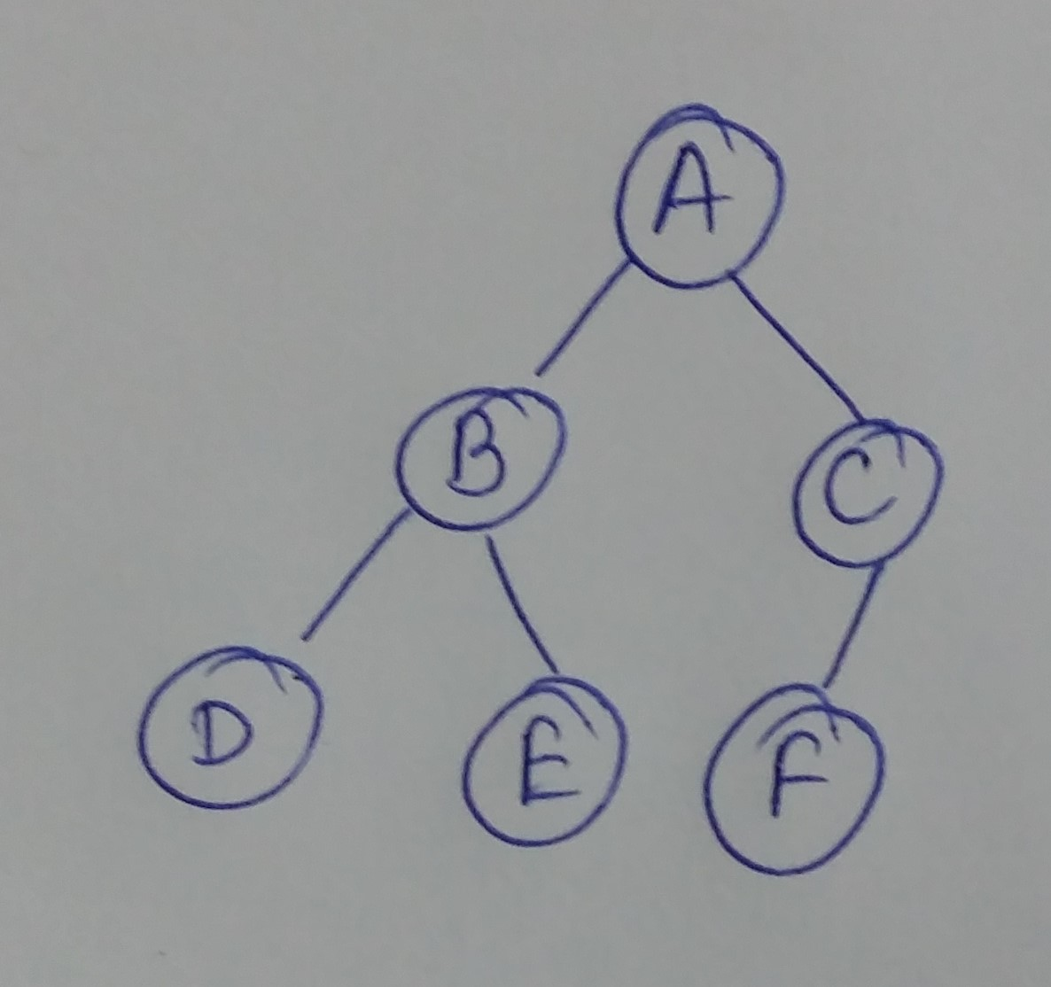

Slide 54
Construct Tree from given Inorder and Preorder traversals
Let us consider the below traversals:
Inorder sequence: D B F E A G C L J H K
Preorder sequence: A B D E F C G H J L K

Slide 55
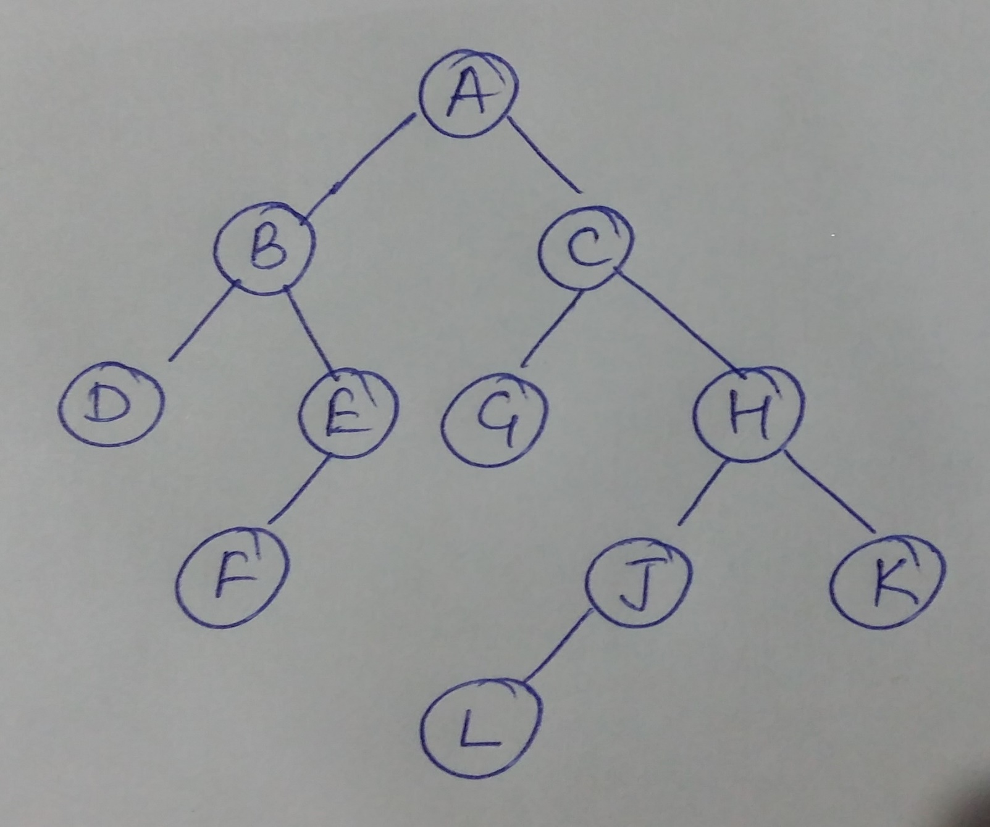

Slide 56
Algorithm: buildTree()
1) Pick an element from Preorder. Increment a Preorder Index Variable to pick next element in next recursive call.
2) Create a new tree node tNode with the data as picked element.
3) Find the picked element’s index in Inorder. Let the index be ‘i’.
4) Call buildTree for elements before ‘i’ and make the built tree as left subtree of tNode.
5) Call buildTree for elements after ‘i’ and make the built tree as right subtree of tNode.
6) return tNode.

Slide 57
Construct Tree from given Inorder and Postorder traversals
Let us consider the below traversals:
Inorder sequence: { 2, 1, 3 }
Postorder sequence: { 2, 3, 1 }

Slide 58
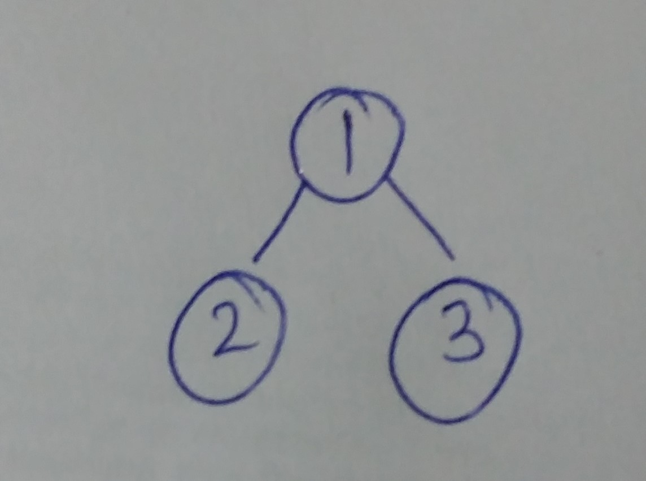

Slide 59
Construct Tree from given Inorder and Postorder traversals
Let us consider the below traversals:
Inorder sequence: { 4, 8, 2, 5, 1, 6, 3, 7 }
Postorder sequence: { 8, 4, 5, 2, 6, 7, 3, 1 }

Slide 60
